Slide 1
Screening for Order Parameter Redundancy
Pavan Ravindra

Slide 2
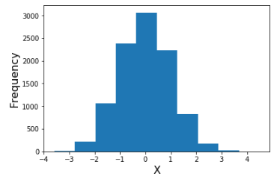
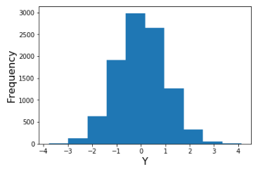
Order Parameter Selection
Biophysical knowledge or intuition
Redundancy not always obvious

Slide 3
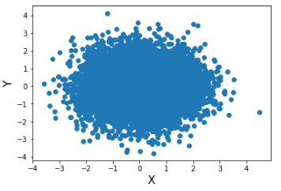
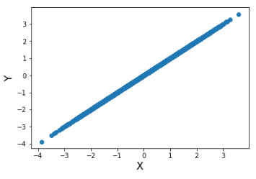
Answer?
Vs.
You would need to look at joint distribution for every pair of OP’s!
Always inconvenient, sometimes impossible

Slide 4
Formal Description of Problem
Given: set of order parameters (and their trajectories)
Return: smallest set of order parameters that still describes system
Essentially, we want to screen for redundant order parameters
Small-scale: Given set of 12 order parameters, how many of these do we actually need?
Large-scale: Given 500 order parameters, how many capture different degrees of freedom?

Slide 5
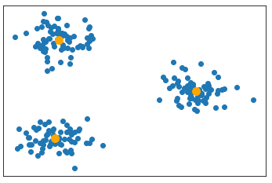
Overview of Approach
Cluster OP’s in some meaningful space
Select a single OP from each cluster
Return best set of OP’s
Problems:
No identifiable low-dimensional OP space
Number of clusters

Slide 6
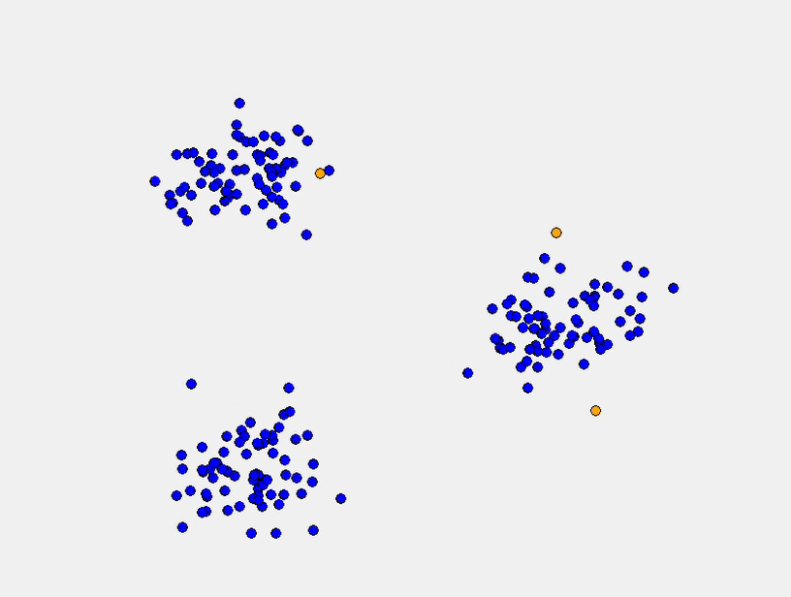
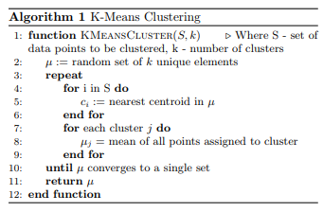
K-Means Clustering
Groups a set of data points into some provided number k clusters

Slide 7
Defining a Distance Function
Need to define distance between 2 points (order parameters)
Points with small distances:
Will be clustered together
Only one OP in each cluster is needed
Points with large distances:
Will not be clustered together
Should be described by different OP’s
Choose one OP from each cluster

Slide 8
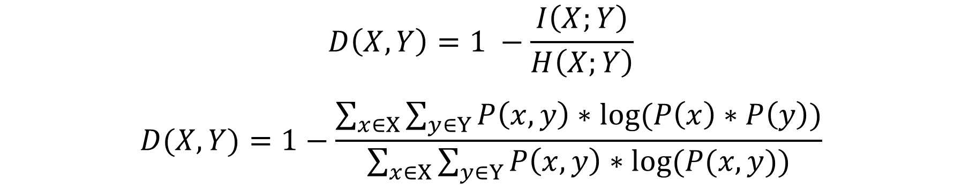
Mutual Information Based Distance Function
$$D\left(X,Y\right)=1 −\frac{I\left(X;Y\right)}{H\left(X;Y\right)}$$
$$D(X,Y)=1−\frac{\sum_{x∈X}{\sum_{y∈Y}{P\left(x, y\right)∗log⁡(P\left(x\right)∗P\left(y\right))}}}{\sum_{x∈X}{\sum_{y∈Y}{P\left(x, y\right)∗log⁡(P(x,y))}}}$$
Symmetric: D(X,Y) = D(Y,X)
Normalized in range [0, 1]
Small distances: large difference between joint distribution and independence assumption
Large distances: Joint distribution is similar to independent OP’s

Slide 9
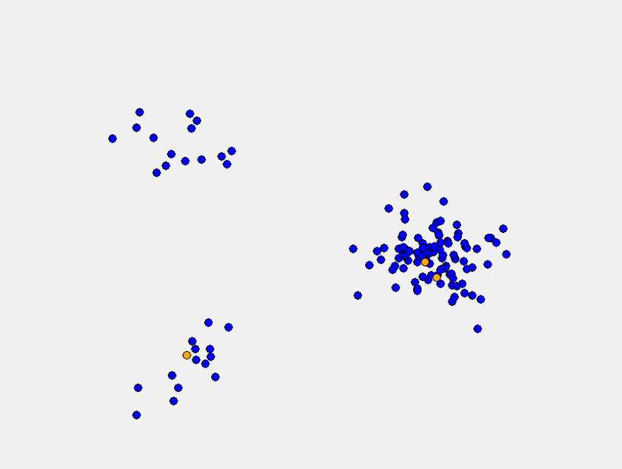
Requirements of Clustering in this System
Centroids must be in the original data set
Non-element centroids are physically meaningless
Initial randomized centroids can get stuck in the same cluster

Slide 10
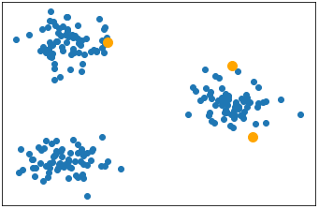
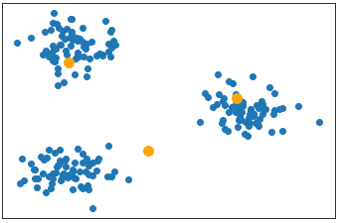
K-Means Clustering
Groups a set of data points into some provided number k clusters
Initial centroids in same space as S
Centroids are flexible (not in S)
Move from one cluster to another

Slide 11
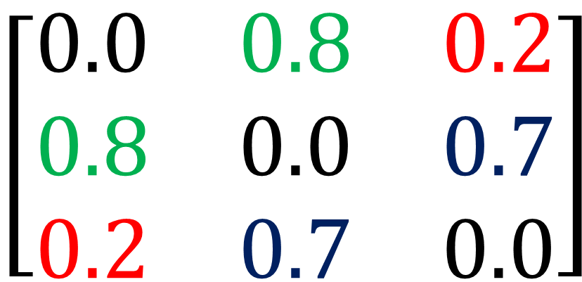
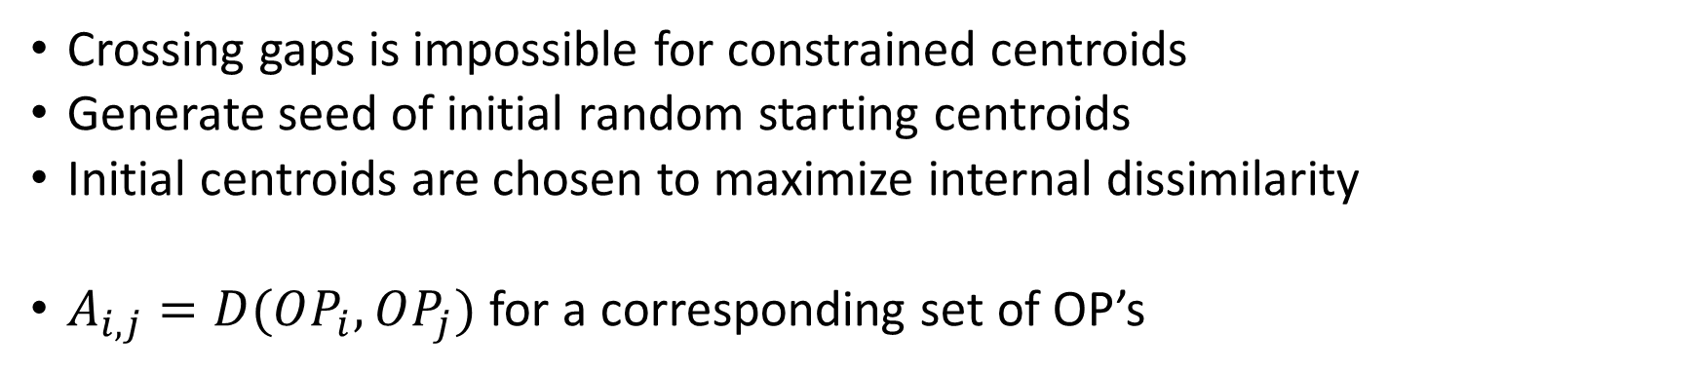
Dissimilarity Matrix
Crossing gaps is impossible for constrained centroids
Generate seed of initial random starting centroids
Initial centroids are chosen to maximize internal dissimilarity
$A_{i,j}=D(OP_{i},OP_{j})$ for a corresponding set of OP’s
$$\left[\begin{matrix}0.0 & 0.8 & 0.2 \\ 0.8 & 0.0 & 0.7 \\ 0.2 & 0.7 & 0.0\end{matrix}\right]$$
Interesting Properties:
Main diagonal is all 0’s:
D(X, X) = 0
Dissimilarity matrix is symmetric:
A_{i,j} = D(I, J) = D(J, I) = A_{j,i}
Product of a row (without diagonal):
Dissimilarity with entire set

Slide 12
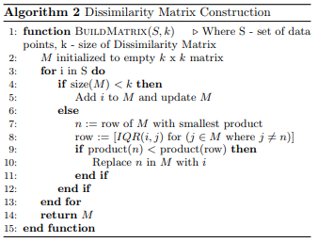
Constructing the Dissimilarity Matrix
Finds k most dissimilar elements of S
Dissimilarity matrix is initialized to some size k
If matrix is not full:
Next OP is added
If matrix is full:
Check if new OP is more dissimilar than an existing OP
Replace old OP with new OP if necessary

Slide 13
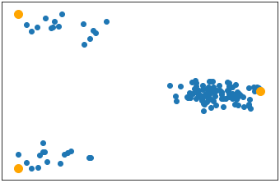
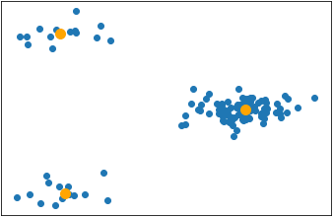
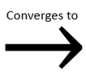
New Starting Point for Clustering
Initial centroids are selected to start far apart
Starting centroids ARE NOT good at describing entire system
For proper k, centroids do not need to cross gaps

Slide 14
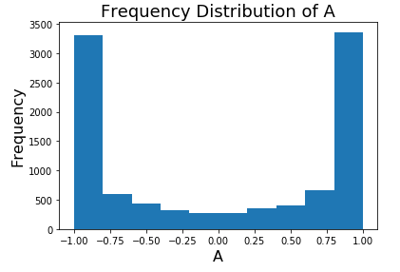
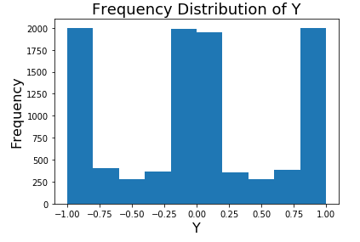
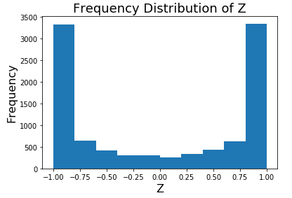
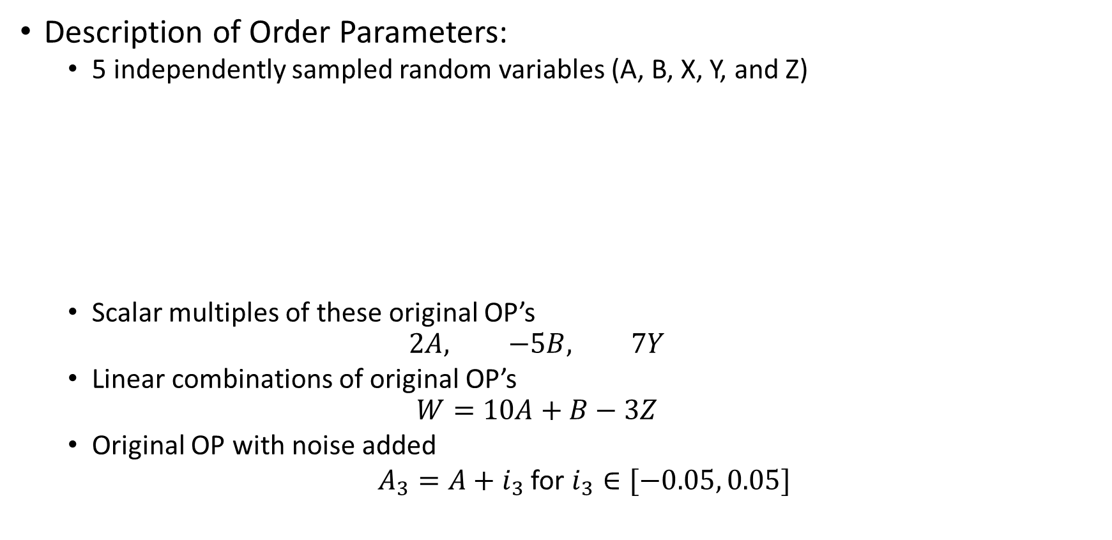
Model System
Description of Order Parameters:
5 independently sampled random variables (A, B, X, Y, and Z)
Scalar multiples of these original OP’s
$$2A, −5B, 7Y$$
Linear combinations of original OP’s
$$W=10A+B−3Z$$
Original OP with noise added
$A_{3}=A+i_{3}$ for $i_{3}∈[−0.05, 0.05]$

Slide 15
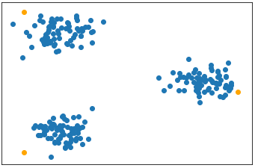
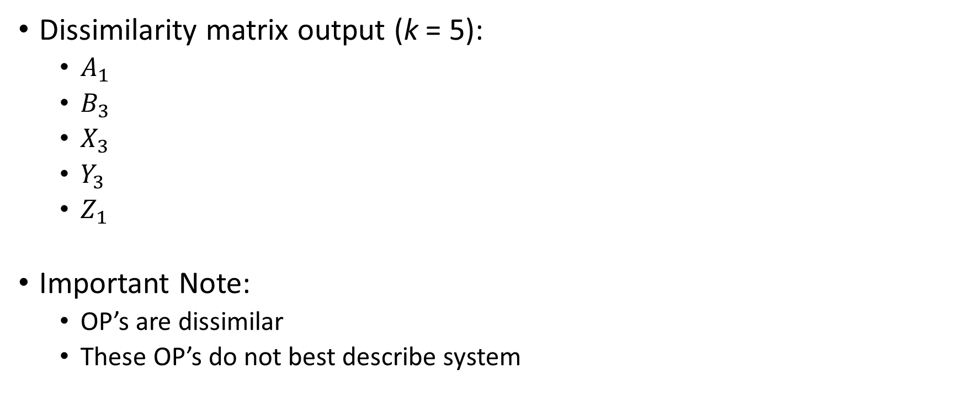
Model System (Results)
Dissimilarity matrix output (k = 5):
$A_{1}$
$B_{3}$
$X_{3}$
$Y_{3}$
$Z_{1}$
Important Note:
OP’s are dissimilar
These OP’s do not best describe system

Slide 16
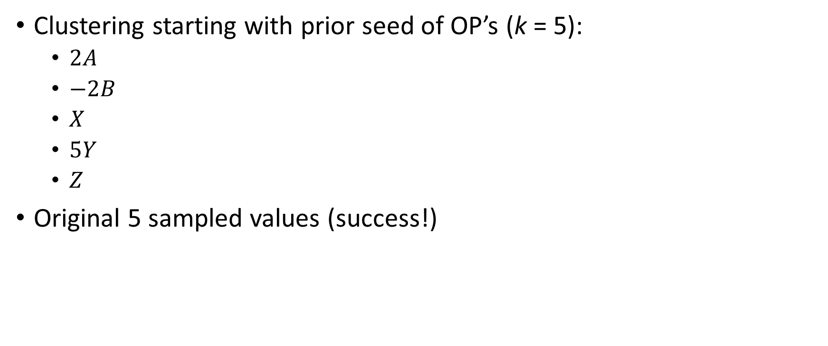
Model System (Results)
Clustering starting with prior seed of OP’s (k = 5):
$2A$
$−2B$
$X$
$5Y$
$Z$
Original 5 sampled values (success!)

Slide 17
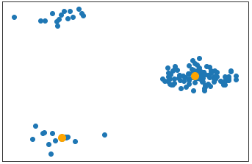
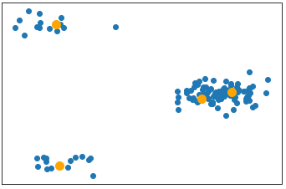
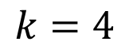
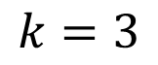
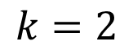
Progress?
What we have:
For a given number k, we can find the k best OP’s to describe entire set of OP’s
What we don’t have:
A robust method of determining the best k for a set of OP’s
$$k=2$$
$$k=3$$
$$k=4$$

Slide 18
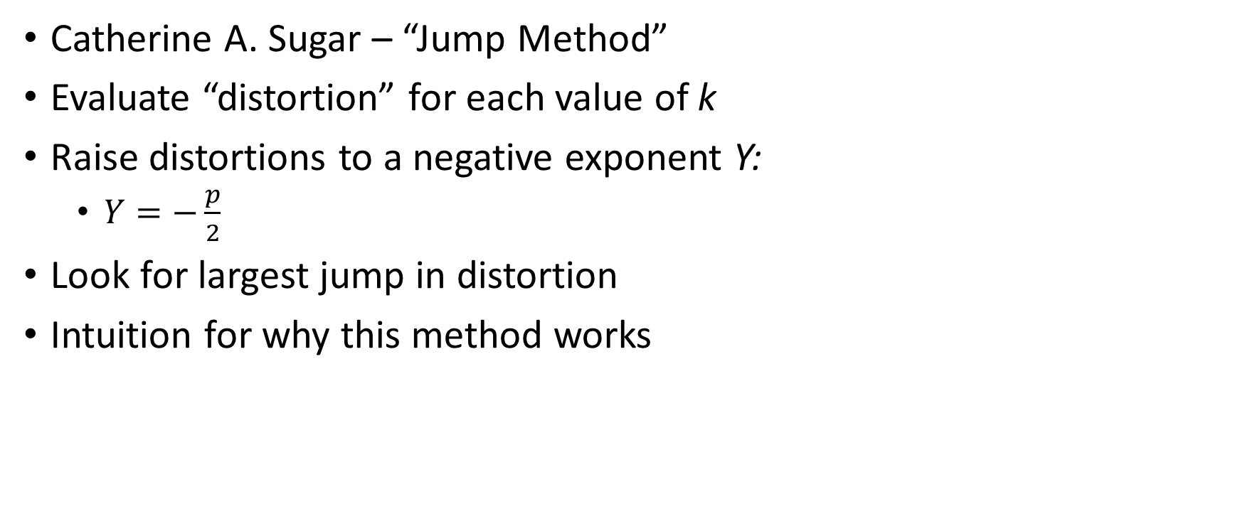
Rate Distortion Theory
Catherine A. Sugar – “Jump Method”
Evaluate “distortion” for each value of k
Raise distortions to a negative exponent Y:
$Y=−\frac{p}{2}$
Look for largest jump in distortion
Intuition for why this method works

Slide 19
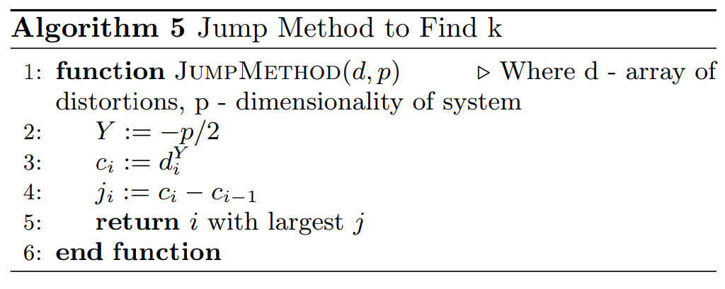
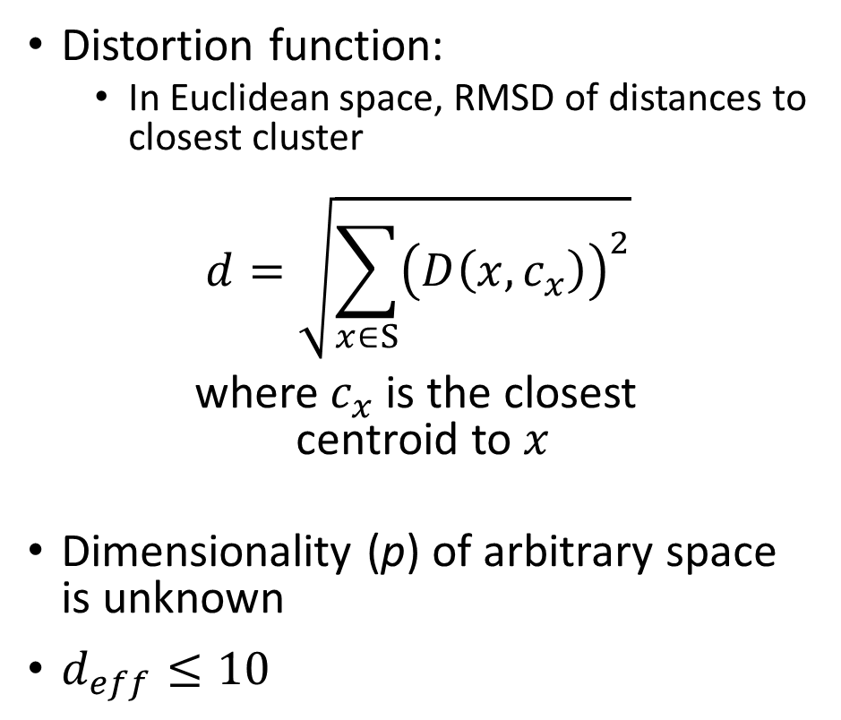
Jump Method
Find number of clusters k in a dataset
Distortion function:
In Euclidean space, RMSD of distances to closest cluster
$$d=\sqrt{\sum_{x∈S}{{\left(D\left(x,c_{x}\right)\right)}^{2}}}$$
where $c_{x}$ is the closest centroid to $x$
Dimensionality (p) of arbitrary space is unknown
$d_{eff}≤10$

Slide 20
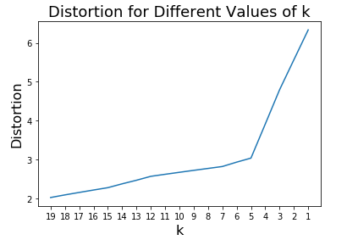

Slide 21
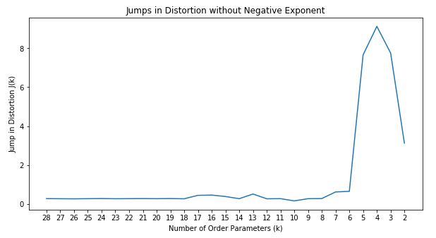

Slide 22
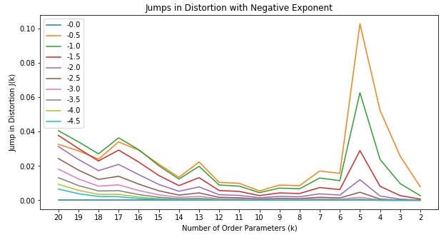
Back to Model System
Clear jump at k = 5 consistent for all choices of Y

Slide 23
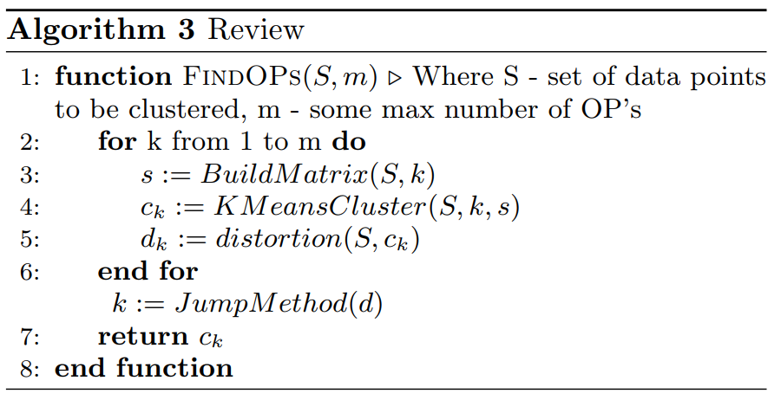
Review of Entire Algorithm

Slide 24
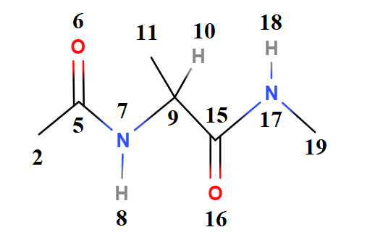
Alanine Dipeptide
Phi: 5,7 – 9,15
Psi: 7,9 – 15,17
Redundant Dihedrals
5,7 – 9, 10
5,7 – 9,11
Distances:
1 -> 9
1 -> 17
8 -> 18
10,9 – 15,17
11,9 – 15,17

Slide 25
Results for Alanine Dipeptide
Dissimilarity Matrix:
Distance: 1 – 17
Distance 2 – 19
Distance 8 – 18
Dihedral Angle: 5,7 – 9,11
Equivalent to phi
Psi
Final Results (5 OP’s):
Dihedral Angle: 5,7 – 9,11
Equivalent to phi
Psi
All 3 distances:
1 – 17
2 – 19
8 – 18
Observations:
Correct number of OP’s returned
OP’s are good representation of entire provided dictionary
Results for k = 2:
Dihedral Angle: 5,7 – 9,11
Again, equivalent to phi
Psi

Slide 26
Next Steps
More interesting system?
Entire trajectory
Use existing dictionary of order parameters and compare results with reduced dictionary
Look at distances between alpha carbons?
Measure some observable (i.e. binding affinity)

